Slide 1

PokeClinic:A model to predict and increase recruitment rate(RR) in clinical trials
Aayush Sharma(22BAI70632)
Yash Tripathi(22BAI70632)

Slide 2
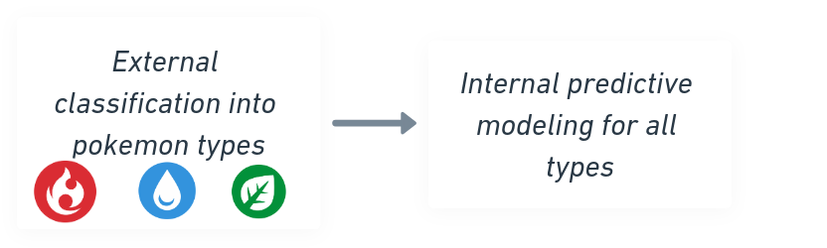



Approach & methodology
Overview
Methodology
Framework / tools used
Understanding the Problem
Recruitment rates in clinical trials often face challenges due to limited outreach, complex criteria, and participant hesitation. Efficiently predicting recruitment success is crucial for benchmarking.
Approach to Solve the Problem
PokeClinic is a prediction model designed to forecast clinical trial recruitment success. It classifies trials into 13 types (e.g., Fire, Ice) based on demographics and recruitment patterns.
PokeClinic enhances clinical trial recruitment rate prediction by a system that uses a classification and predictive pipeline for efficient trial matching and outcome predictions. Here's a breakdown:
External Classification of Trial Data: Categorize trials into 13 pokemon types (e.g., Fire, Water, Ice) based on given features.
Predictive Modeling: Apply machine learning to predict recruitment success and outcomes for each trial type.
Data Preprocessing: Prepare data by encoding categorical, scaling numerical, and using NLP for text-based features.
Training & Validation: Train predictive models on historical data and validate using performance metrics.
Deployment & Feedback: Deliver real-time insights to organizers and continuously improve models with new data.
For PokeClinic, the choice of frameworks, libraries, and tools depends on the pipeline stages and the tasks involved. Here's a breakdown:
1.Machine Learning:
scikit-learn
XGBoost/LightGBM
2.Deep Learning & NLP
TensorFlow/Keras or PyTorch
Hugging Face Transformers
3.Data Processing & Visualization
Pandas/NumPy
Matplotlib/Seaborn

Slide 3
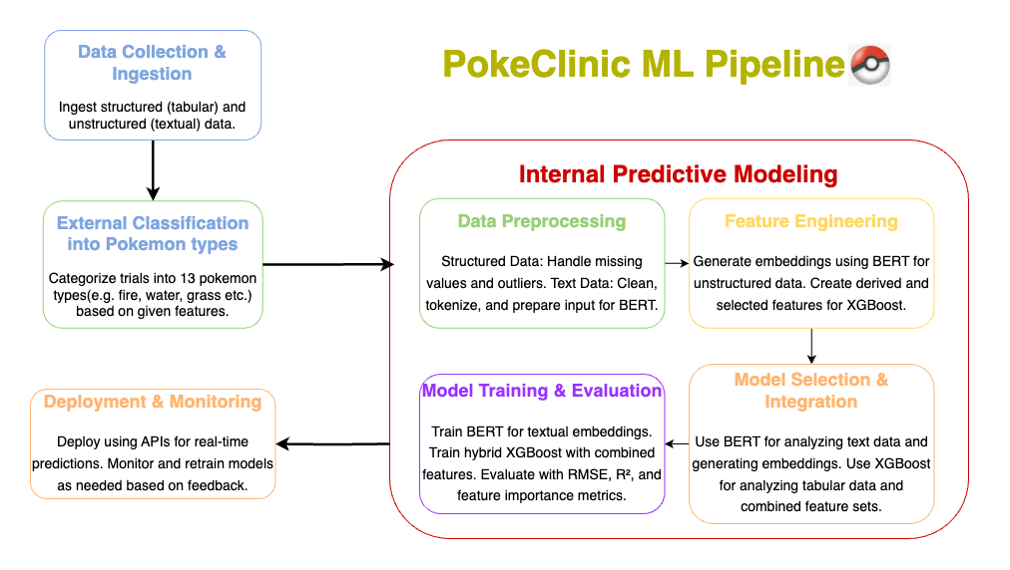
Model choice & setup
Model Selection
Model Architecture
Models Used and their rationale
XGBoost: Excels at predicting recruitment rates using structured data like demographics and trial metrics, ensuring high accuracy and efficiency.
BERT: Processes trial descriptions and summaries, extracting contextual insights from text for better trial matching.
K-Means: Clusters users and trials based on recruitment patterns, aiding Pokémon-type categorization.
DBSCAN: Identifies outliers and forms clusters in dense, non-linear data, helping analyze niche trials or rare demographics.
This combination leverages XGBoost’s precision, BERT’s NLP capabilities, and clustering for robust recruitment prediction and categorization.
End-to-end ML pipeline

Slide 4
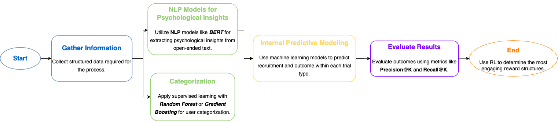
Model Training & Evaluation
Evaluation Metrics
Model Training Process
Evaluation Criteria and Metrics for PokeClinic
1. Prediction Accuracy:
Root Mean Square Error (RMSE) and Mean Absolute Error (MAE) measure the accuracy of recruitment predictions by quantifying the deviation from actual values.
R-squared (R²) evaluates how well the model explains the variance in recruitment rates.
2.Trial Matching Performance:
Precision@K and Recall@K gauge how effectively the system suggests relevant clinical trials to users.
Mean Reciprocal Rank (MRR) evaluates the ranking quality of trial recommendations.

Slide 5
Results and visualization
Model Outcomes
Explainability
Key Findings and Implications
Predictive models accurately forecast recruitment success for clinical trials, aiding benchmarking efforts.
Trial classification (e.g., Fire, Ice types) highlights recruitment trends across demographics and conditions.
Visual Aids for PokeClinic
Heatmaps: Correlation between participant attributes and recruitment success.
Trial Type Comparisons: Use stacked bar charts or pie charts to display recruitment distribution across the 13 trial types.
Geographical map : Use map to visualize the Rate of Recruitment at the particular geographical location and to classify
Why Explainability Matters?
Builds trust with trial organizers by providing clear insights into predictions.
Helps refine recruitment strategies and improve trial design.
Techniques for Explainability
Partial Dependence Plots (PDPs):
Visualizes how features impact predicted outcomes.
Helps understand global trends in the model’s behavior.

Slide 6
Challenges & Next Steps
Limitations
Next Steps
Caveats, and Potential Biases in PokeClinic
1.Data Limitations:
Imbalanced Data.
Data Quality
2.Model Bias:
Demographic Bias
Feature Bias
Caveats, and Potential Biases in PokeClinic
1.Data Limitations:
Imbalanced Data.
Data Quality
2.Model Bias:
Demographic Bias
Feature Bias
Caveats, and Potential Biases in PokeClinic
1.Data Limitations:
Imbalanced Data
Data Quality
2.Model Bias:
Demographic Bias
Bias-Variance Trade-Off
Progression Plan for PokeClinic
App Development: Create a user-friendly app integrating gamification to enhance engagement and to increase recruitment rate in clinical trials.
Interactive Interviews: Design psychological questions to assess user traits and preferences.
Pokémon-Type Assignment: Assign a Pokémon-inspired type based on user responses to match them with suitable clinical trials.
Trial Matching: Use the assigned type to recommend relevant clinical trials, improving recruitment rates.
Incentives and Rewards: Motivate users to participate by offering rewards or medical royalties.
Feedback and Optimization: Continuously refine the app experience based on user feedback and recruitment success.
Bais-Variance Trade-off

Slide 7

THANK YOU

